Slide 1
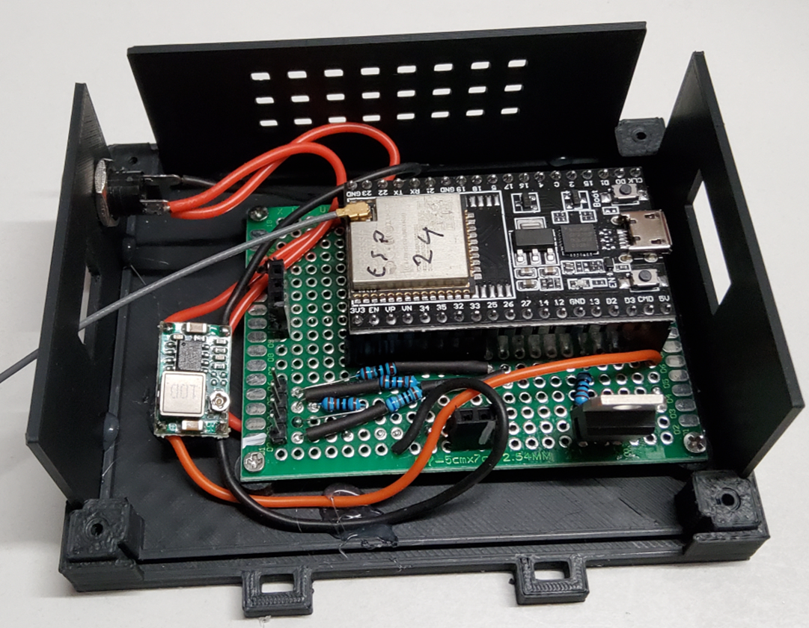
Sensor
GND
Data
3,3V
GND
+
FAN
LEDs
PWM
RPM
12V
GND

Slide 2
